Slide 1
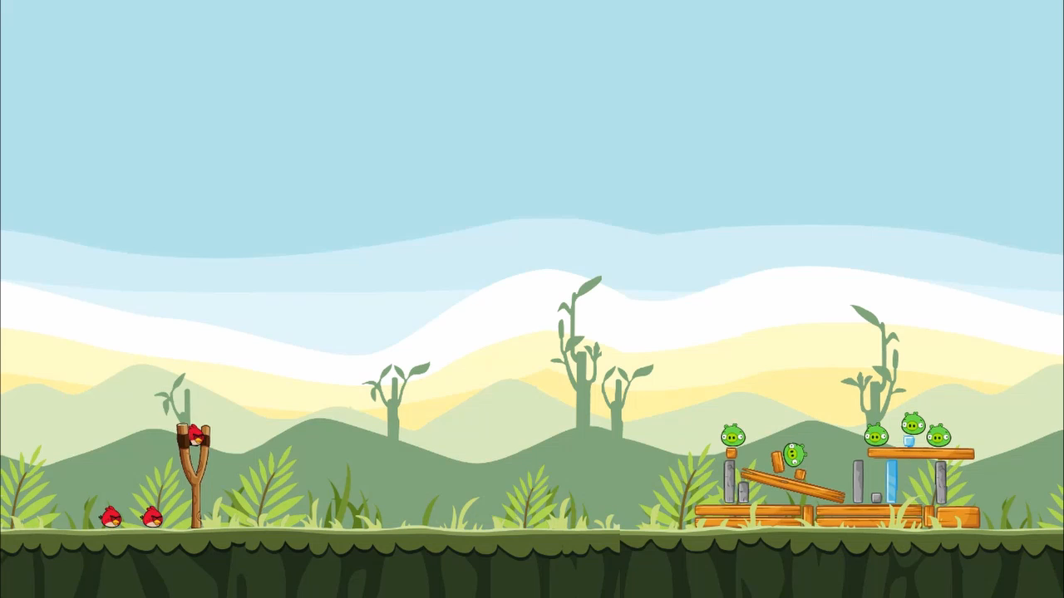

Master Thesis - Defense
Utilizing generative adversarial networks for stable structure generation in a physics-based simulation.
By: Frederic Abraham
Supervisor:
Dr. Matthew Stephenson

Slide 2
Master Thesis - Defense
Utilizing generative adversarial networks for stable structure generation in a physics-based simulation.
By: Frederic Abraham
Supervisor:
Dr. Matthew Stephenson

Slide 3

Outline
Introduction
Background Information
Problem Statement / Research Question
Outlier Detection
Concepts
Metadata Model
One-class Support Vector machines
Interpretability
Approach
Evaluation
Results
Continues Training
Feature Influences
Discussion
Different Classifications
Future Work
Conclusion

Slide 4
Introduction
Background Information + Problem Statement / Research Question

Slide 5
GANs & PCGML
Training – Difficulties – GAN PCGML – Angry Birds Level Generation

Slide 6
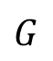
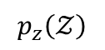
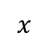
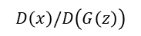
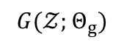
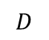
Real Dataset
$$x$$
GAN - Structure
Update Discriminator Weights
Noise variable
Discriminator
Loss
Discriminator
or
Critic
$$p_{z}\left(𝒵\right)$$
$$D$$
Real / Fake
Evaluation
Generator
$$G$$
Generate
fake
examples
$$D\left(x\right)/D\left(G\left(z\right)\right)$$
Generator
Loss
Fake
Data Space
$$G(𝒵;Θ_{g})$$
Update Generator Weights

Slide 7
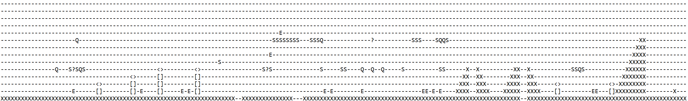
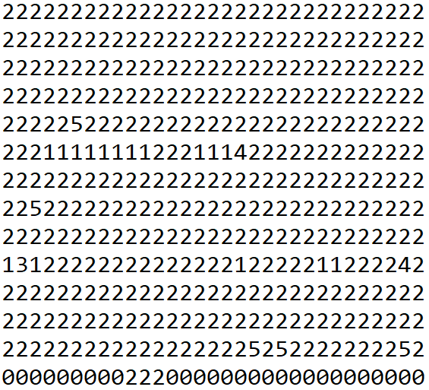
Mario - GAN
Mappings
32
0
1
2
3
1
Platform
1
1
4
1
5
32
1
0
6
1
0
1
0
1
0
1
7
1
1
Air gap
1
1
1
1
1
0
8
1
0
1
0
9
10

Slide 8
Concepts
SUOD, One-Class Support Vector Machines, Interpretebility

Slide 9
Encodings
Encoding
Level Representation
Uses
One-Element
Encoding
XML Level Description
Raster Size Selection
Visual
Encoding
Multilayer Representation
Dot Encoding
Single Layer
Calculated Encoding
Multilayer with air
Decoding
Multilayer without air
Recursive Rectangle
Decoding
Confidence Decoding
One-Element
Encoding
True One Hot

Slide 10
Raster size Selection
Encoding
Raster Size Selection
Output GAN
Resolution
Representation Detail

Slide 11
Resolution Table
Width | SquareHole | RectFat | SquareSmall | SquareTiny | RectTiny | RectSmall | RectMedium | RectBig | Max
0.01 | 85.0, 85.0 | 85.0, 43.0 | 43.0, 43.0 | 22.0, 22.0 | 43.0, 22.0 | 85.0, 22.0 | 168.0, 22.0 | 206.0, 22.0 | 0
0.02 | 42.5, 42.5 | 42.5, 21.5 | 21.5, 21.5 | 11.0, 11.0 | 21.5, 11.0 | 42.5, 11.0 | 84.0, 11.0 | 103.0, 11.0 | 0.5
0.03 | 28.33, 28.33 | 28.33, 14.33 | 14.33, 14.33 | 7.33, 7.33 | 14.33, 7.33 | 28.33, 7.33 | 56.0, 7.33 | 68.67, 7.33 | 0.67
0.04 | 21.25, 21.25 | 21.25, 10.75 | 10.75, 10.75 | 5.5, 5.5 | 10.75, 5.5 | 21.25, 5.5 | 42.0, 5.5 | 51.5, 5.5 | 0.75
0.05 | 17.0, 17.0 | 17.0, 8.6 | 8.6, 8.6 | 4.4, 4.4 | 8.6, 4.4 | 17.0, 4.4 | 33.6, 4.4 | 41.2, 4.4 | 0.6
0.06 | 14.17, 14.17 | 14.17, 7.17 | 7.17, 7.17 | 3.67, 3.67 | 7.17, 3.67 | 14.17, 3.67 | 28.0, 3.67 | 34.33, 3.67 | 0.67
0.07 | 12.14, 12.14 | 12.14, 6.14 | 6.14, 6.14 | 3.14, 3.14 | 6.14, 3.14 | 12.14, 3.14 | 24.0, 3.14 | 29.43, 3.14 | 0.43
0.08 | 10.62, 10.62 | 10.62, 5.38 | 5.38, 5.38 | 2.75, 2.75 | 5.38, 2.75 | 10.62, 2.75 | 21.0, 2.75 | 25.75, 2.75 | 0.75
0.09 | 9.44, 9.44 | 9.44, 4.78 | 4.78, 4.78 | 2.44, 2.44 | 4.78, 2.44 | 9.44, 2.44 | 18.67, 2.44 | 22.89, 2.44 | 0.89
0.1 | 8.5, 8.5 | 8.5, 4.3 | 4.3, 4.3 | 2.2, 2.2 | 4.3, 2.2 | 8.5, 2.2 | 16.8, 2.2 | 20.6, 2.2 | 0.8
0.11 | 7.73, 7.73 | 7.73, 3.91 | 3.91, 3.91 | 2.0, 2.0 | 3.91, 2.0 | 7.73, 2.0 | 15.27, 2.0 | 18.73, 2.0 | 0.91
0.12 | 7.08, 7.08 | 7.08, 3.58 | 3.58, 3.58 | 1.83, 1.83 | 3.58, 1.83 | 7.08, 1.83 | 14.0, 1.83 | 17.17, 1.83 | 0.83
0.13 | 6.54, 6.54 | 6.54, 3.31 | 3.31, 3.31 | 1.69, 1.69 | 3.31, 1.69 | 6.54, 1.69 | 12.92, 1.69 | 15.85, 1.69 | 0.92
0.14 | 6.07, 6.07 | 6.07, 3.07 | 3.07, 3.07 | 1.57, 1.57 | 3.07, 1.57 | 6.07, 1.57 | 12.0, 1.57 | 14.71, 1.57 | 0.71
0.15 | 5.67, 5.67 | 5.67, 2.87 | 2.87, 2.87 | 1.47, 1.47 | 2.87, 1.47 | 5.67, 1.47 | 11.2, 1.47 | 13.73, 1.47 | 0.87
0.16 | 5.31, 5.31 | 5.31, 2.69 | 2.69, 2.69 | 1.38, 1.38 | 2.69, 1.38 | 5.31, 1.38 | 10.5, 1.38 | 12.88, 1.38 | 0.88
0.17 | 5.0, 5.0 | 5.0, 2.53 | 2.53, 2.53 | 1.29, 1.29 | 2.53, 1.29 | 5.0, 1.29 | 9.88, 1.29 | 12.12, 1.29 | 0.88
0.18 | 4.72, 4.72 | 4.72, 2.39 | 2.39, 2.39 | 1.22, 1.22 | 2.39, 1.22 | 4.72, 1.22 | 9.33, 1.22 | 11.44, 1.22 | 0.72
0.19 | 4.47, 4.47 | 4.47, 2.26 | 2.26, 2.26 | 1.16, 1.16 | 2.26, 1.16 | 4.47, 1.16 | 8.84, 1.16 | 10.84, 1.16 | 0.84

Slide 12
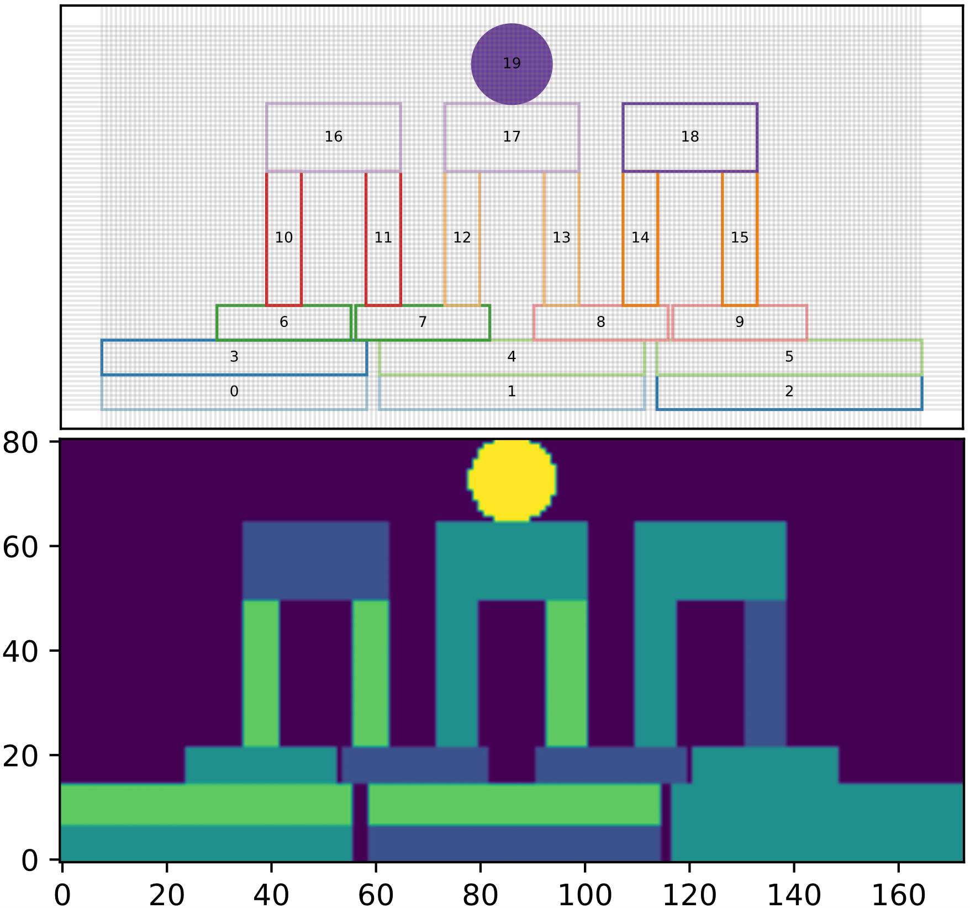
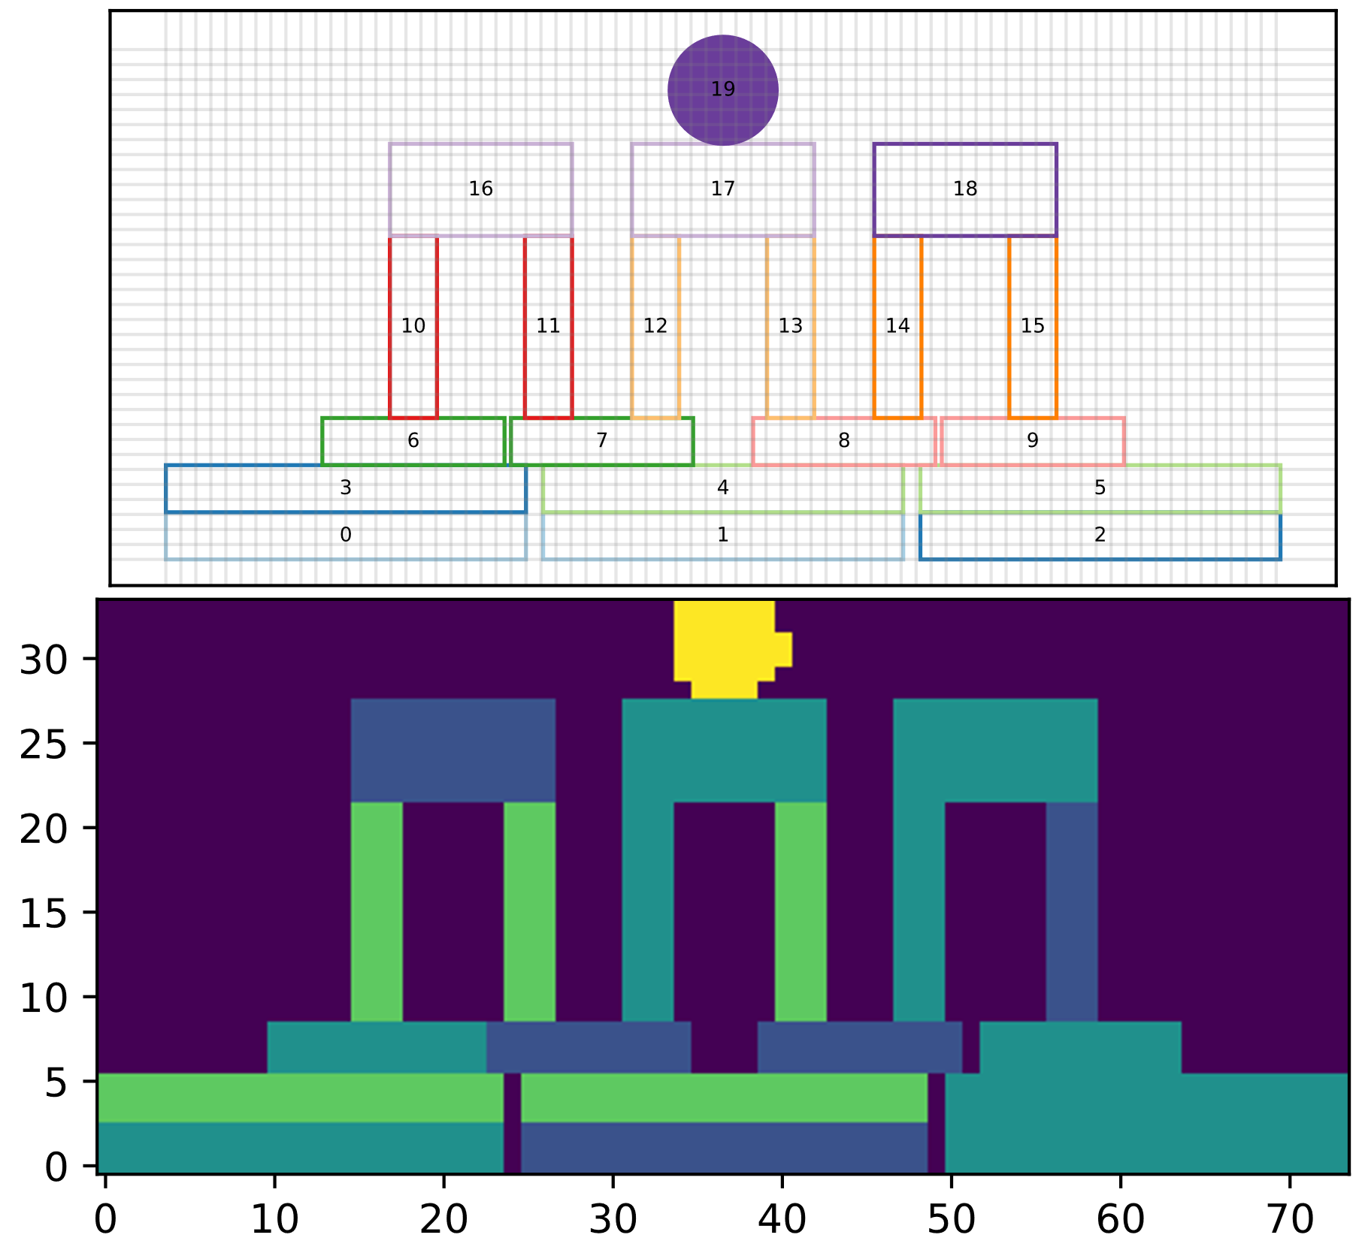
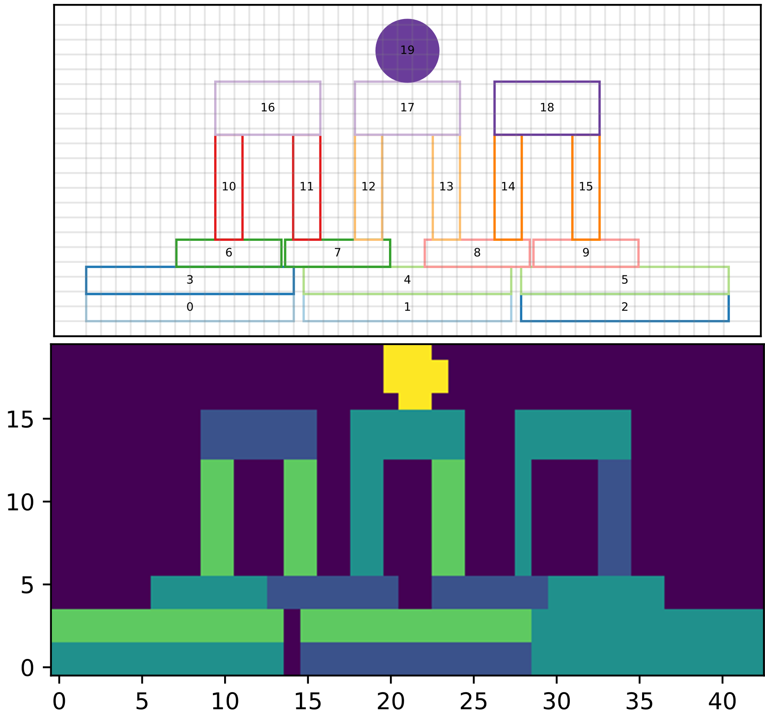
Raster size Selection
Raster Size Selection
Resolution 0.03
(81, 173)
Resolution 0.07
(34, 74)
Resolution 0.12
(22, 43)
Output GAN
Resolution
Representation Detail

Slide 13
Encodings
Encoding
Level Representation
Uses
One-Element
Encoding
XML Level Description
Raster Size Selection
Visual
Encoding
Multilayer Representation
Dot Encoding
Single Layer
Calculated Encoding
Multilayer with air
Decoding
Multilayer without air
Recursive Rectangle
Decoding
Confidence Decoding
One-Element
Encoding
True One Hot

Slide 14
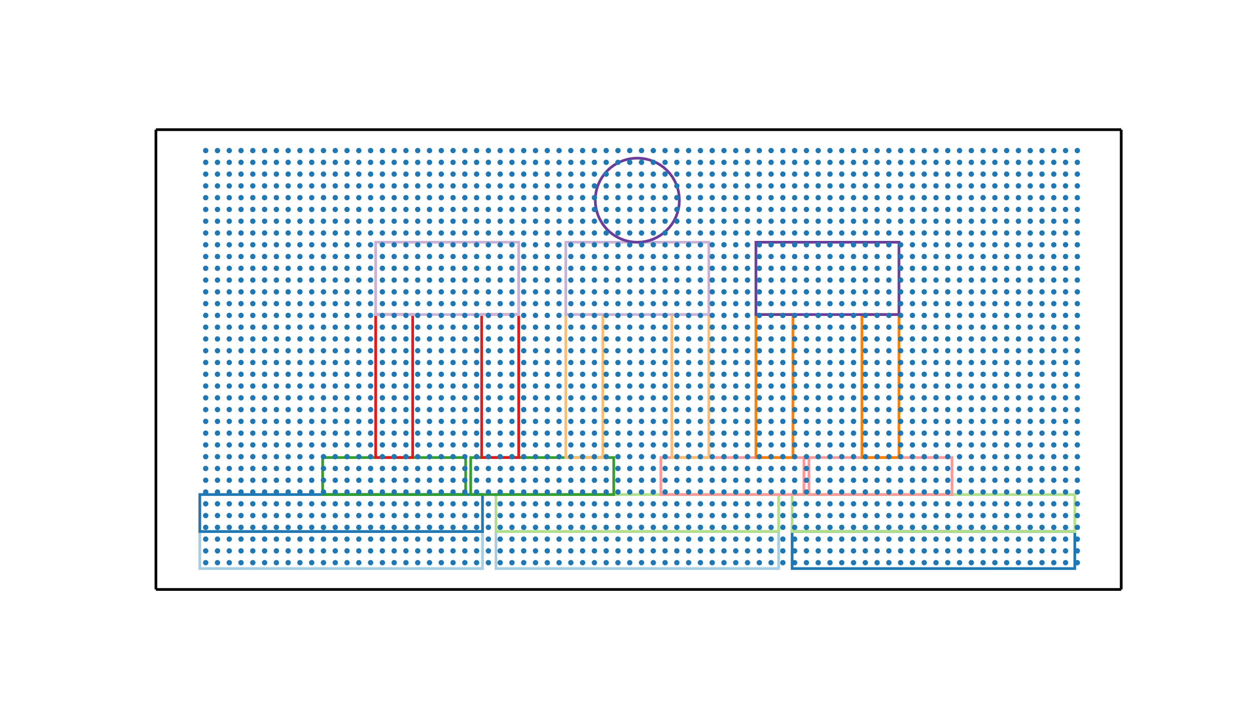
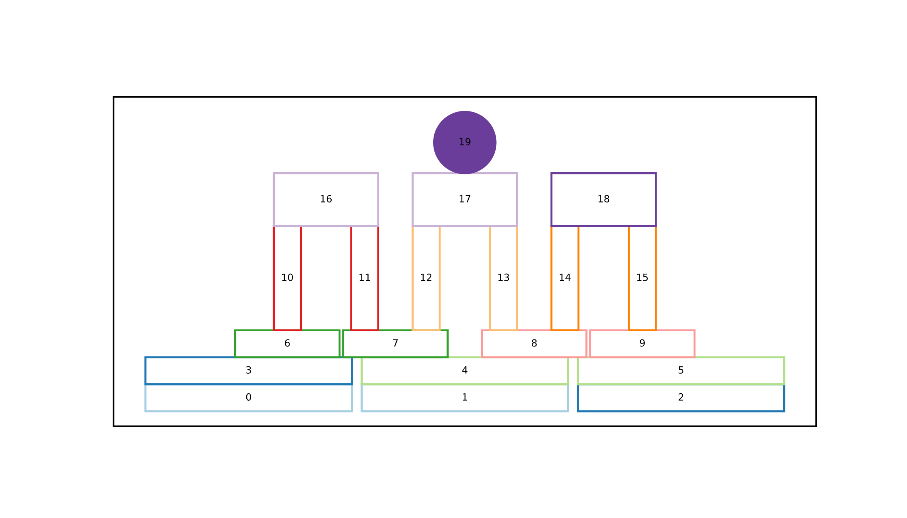

Dot Encoding
Encoding
Visual Encodings
Dot Encoding

Slide 15


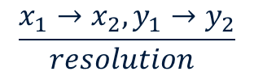
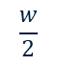
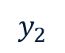
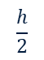

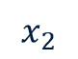
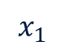
Calculated
Encoding
Visual Encodings
Calculated Encoding
$$\frac{x_{1}→x_{2}, y_{1}→y_{2}}{resolution }$$
$$x_{1}$$
$$x_{2}$$
$$\frac{h}{2}$$
$$y_{1}$$
$$×$$
$$y_{2}$$
$$\frac{w}{2}$$

Slide 16
Ambiguity of visual Encoding
Decoding 1
Original
Decoding 2

Slide 17
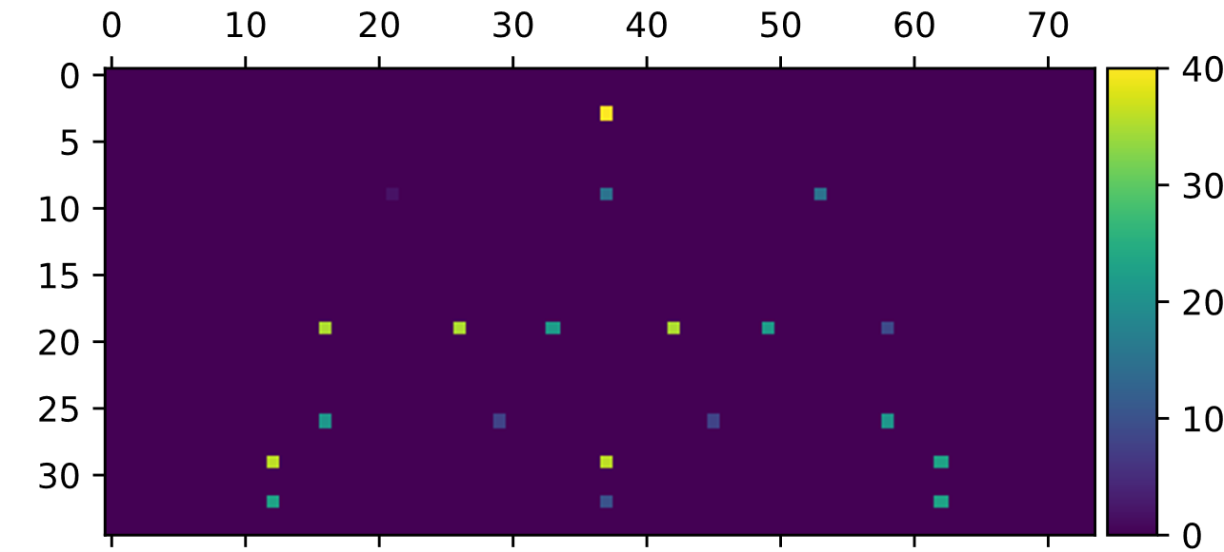

One-Element Encoding
Encoding
One-Element Encoding
Visual Encoding

Slide 18
Encodings
Encoding
Level Representation
Uses
One-Element
Encoding
XML Level Description
Raster Size Selection
Visual
Encoding
Multilayer Representation
Dot Encoding
Single Layer
Calculated Encoding
Multilayer with air
Decoding
Multilayer without air
Recursive Rectangle
Decoding
Confidence Decoding
One-Element
Encoding
True One Hot

Slide 19
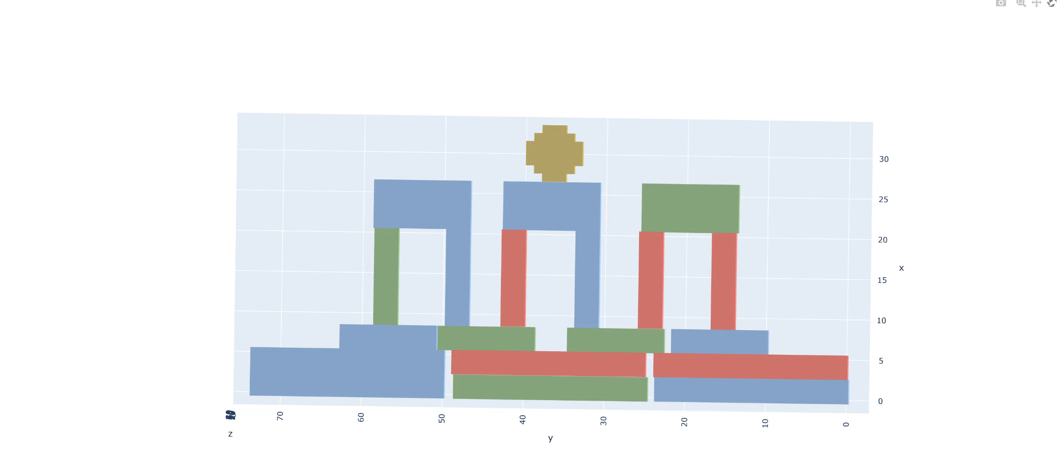
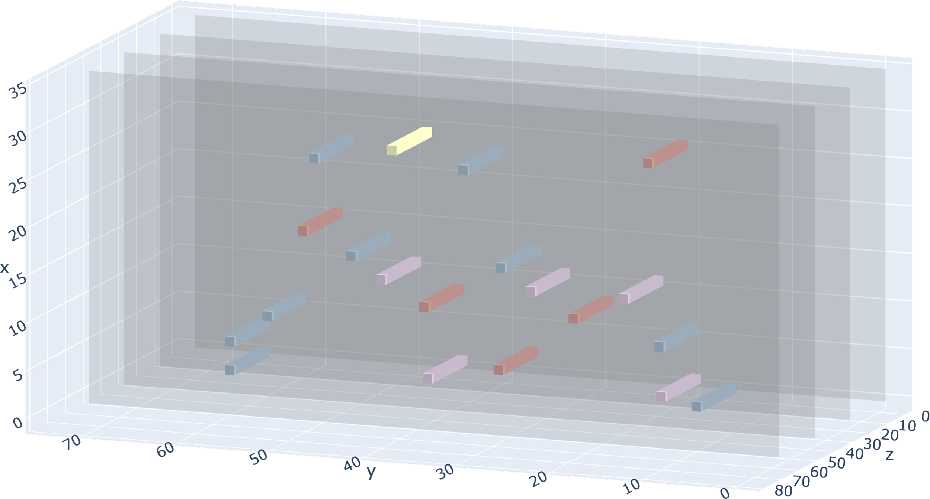
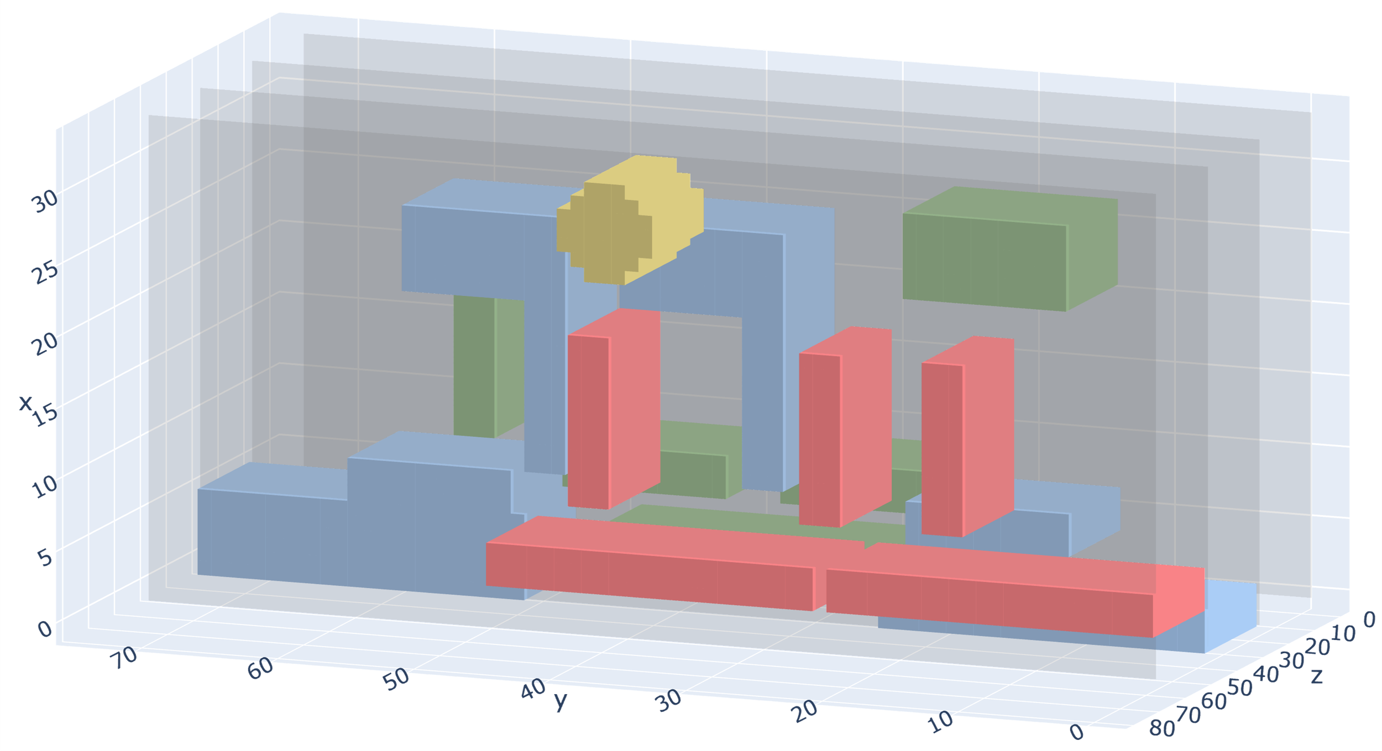
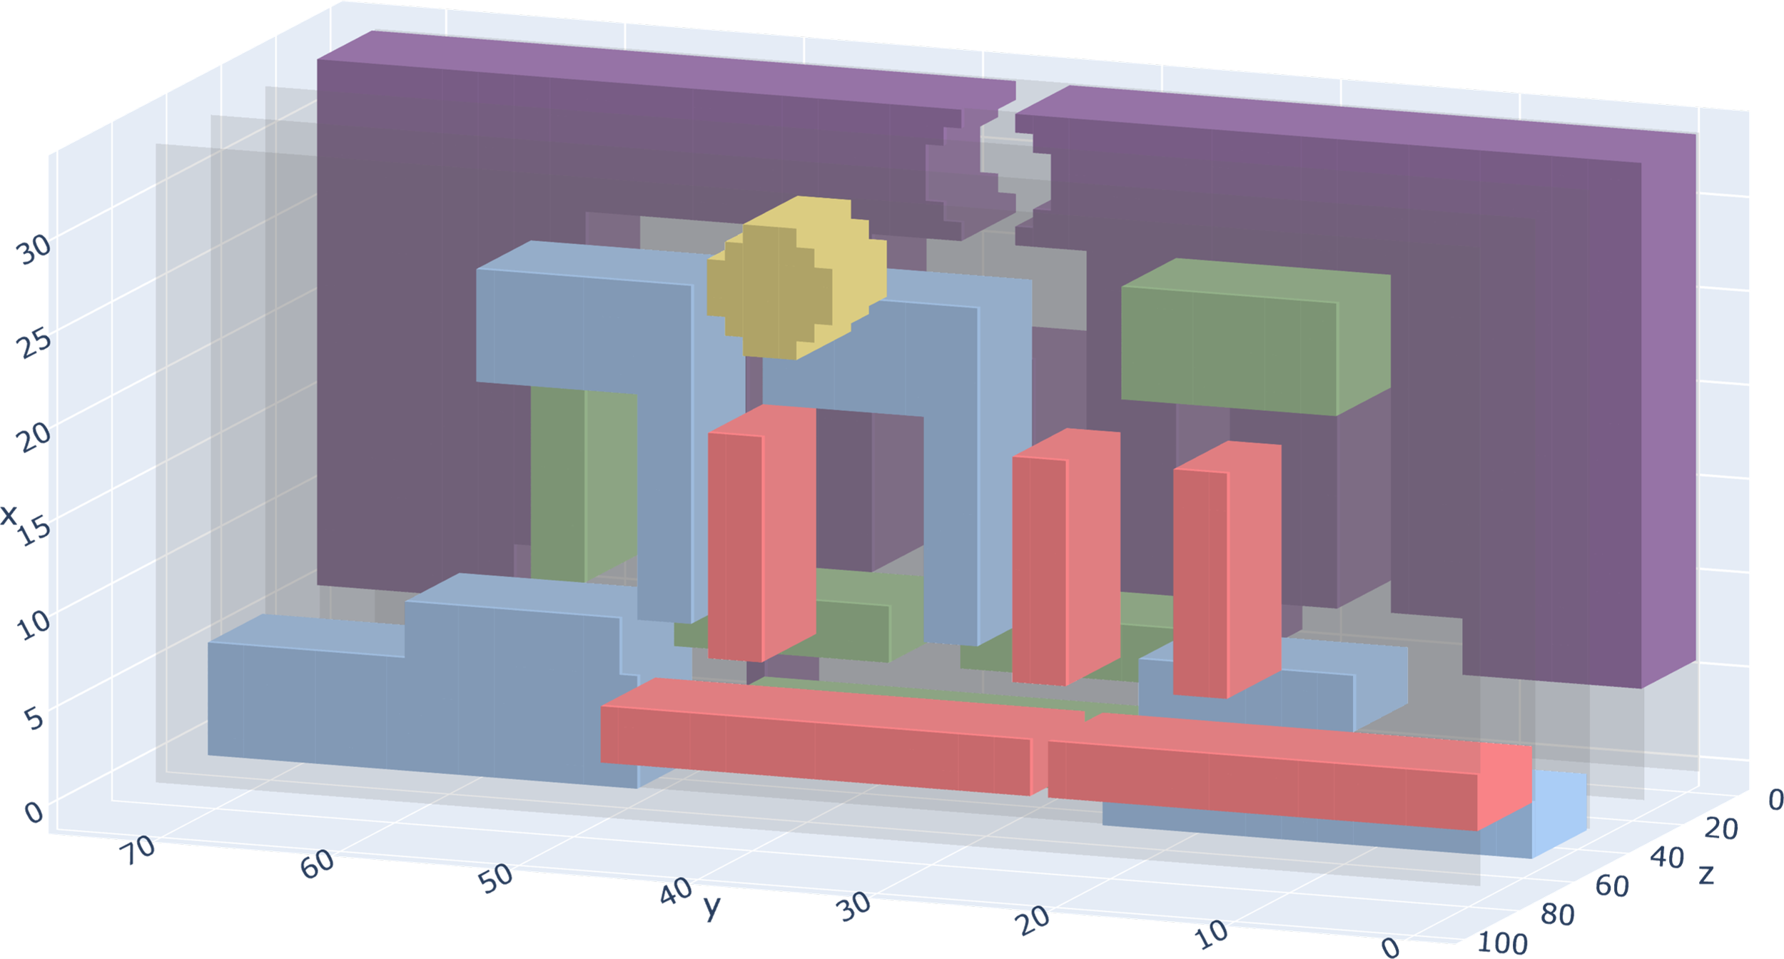
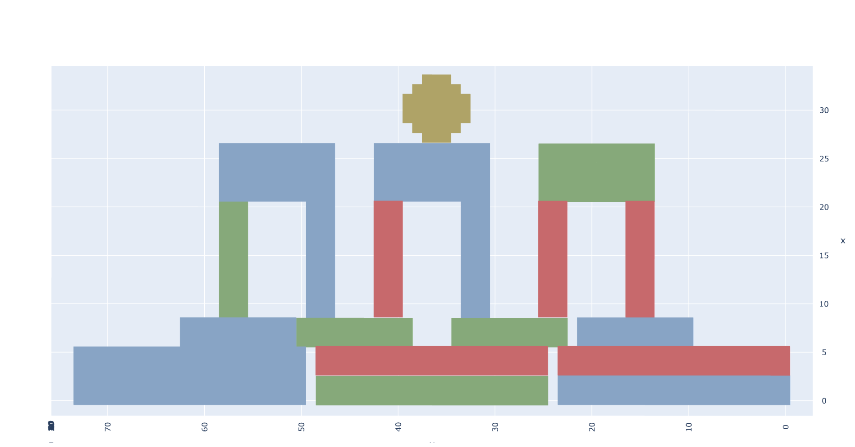
Multilayer Representation
Multilayer Representation

Slide 20
Approach
File Server Model + Feature Extraction + Continues Training + Integration

Slide 21
Evaluation
File Server Model + Feature Extraction + Continues Training + Integration

Slide 22
Discussion & Conclusion
File Server Model + Feature Extraction + Continues Training + Integration

Slide 23
Thanks for your attention! Questions?

